Slide 1

JavaScript Advanced
Course Overview
SoftUni Team
Technical Trainers
Software University
https://softuni.bg

Slide 2
Table of Contents
Introduction
Training & Team
Course Objectives
Course Organization

Slide 3
Have a Question?
sli.do
#js-advanced

Slide 4













SoftUni Diamond Partners

Slide 5
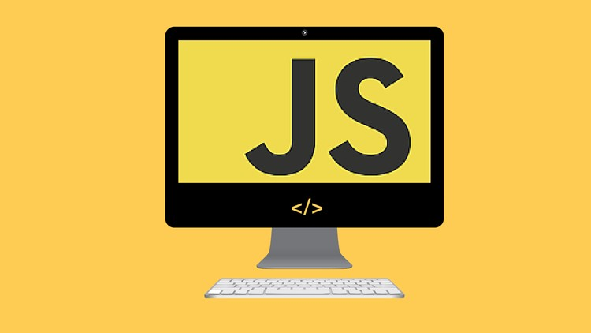
JS Advanced
Course Objectives & Program

Slide 6
Course Objectives
Extends the JS Fundamentals course
Advanced coding skills for the JS language
Use contemporary techniques and paradigms
Master the DOM API and user interaction
Write code to solve realistic practical problems

Slide 7
JS Advanced – Course Topics
Syntax, Functions and Statements
Arrays & Matrices
Objects & Composition
DOM Introduction
DOM Events and Manipulation

Slide 8
JS Advanced – Course Topics
Advanced Functions
Unit Testing
Classes
Prototypes and Inheritance
Workshop

Slide 9

Trainers and Team

Slide 10
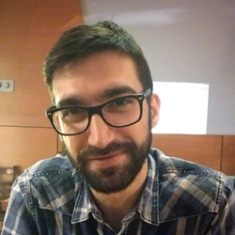
Viktor Kostadinov
Nearly 5 years experience as a technical trainer in the IT field
Head of the R&D Unit at Software University
Former Director of the Education Department
JavaScript enthusiast

Slide 11
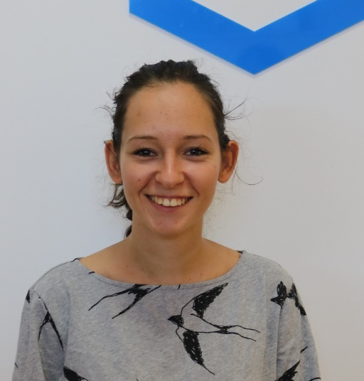
Mihaela Petrova
Junior Fullstack Developer @ Motion Software
Working with React, NodeJS, MongoDB
Former Team Lead in the Education Department
MArch graduate from UACEG

Slide 12

Course Details
Objectives and Schedule

Slide 13

Practical Exam
Structure: 3 problems for 4 hours
Exam: 20 Feb 2021
Retake: 7 Apr 2021
Problems description:
Classes
DOM
Unit Testing

Slide 14
Theoretical Exam
20 questions for 30 minutes
Multiple-choice
English
Automated quiz system
Available online
You can submit your answers just one time

Slide 15
JS Advanced Module Timeline
JS Advanced
Start: 11. Jan 2021
Exam: 20. Feb 2021
11.
20.
6 weeks
4 times per week
January
February
JS Applications
Start: 22. Feb 2021
Exam: 4. Apr 2021
22.
4.
6 weeks
4 times per week
Feb
March
Apr
Exam Retakes
JS Advanced: 7. Apr 2021
JS Applications: 17. Apr 2021
April

Slide 16
Course Scoring
Practice grade:
Theory grade:
SoftUni Certificate: 5.00 from Practice
CPE Certificate: 3.00 average from Practice + Theory
Practical Exam
Homework
100 %
+5 %
Theoretical Exam
100 %
16

Slide 17




Course Web Site, Forum and FB Group
Official web site:
Official discussion forum:
Official Facebook group:
Official SoftUni JavaScript Community:
softuni.bg/trainings/3217/js-advanced-january-2021
softuni.bg/forum/categories/107/
facebook.com/groups/jsadvancedjanuary2021
facebook.com/groups/SoftUniJavaScriptCommunity/

Slide 18
Questions?
Notes:
18

Slide 19
Trainings @ Software University (SoftUni)
Software University – High-Quality Education, Profession and Job for Software Developers
softuni.bg, softuni.org
Software University Foundation
softuni.foundation
Software University @ Facebook
facebook.com/SoftwareUniversity
Software University Forums
forum.softuni.bg
Notes:
19

Slide 20

License
This course (slides, examples, demos, exercises, homework, documents, videos and other assets) is copyrighted content
Unauthorized copy, reproduction or use is illegal
© SoftUni – https://about.softuni.bg/
© Software University – https://softuni.bg
Notes:
20

Slide 21
JS Advanced Module Timeline
January
February
March
April
January
February
March
April
January
February
March
April

Slide 22
JS Advanced Module Timeline
JS Advanced
6 weeks
4 times per week
Retake Exams
Start: 11. Jan 2021
Exam: 20. Feb 2021
JS Advanced: 7. Apr 2021
JS Applications: 10. Apr 2021
January
February
March
April
Start: 22. Feb 2021
Exam: 4. Apr 2021
JS Applications
6 weeks
4 times per week

Slide 23
JS Advanced Module Timeline
JS Advanced
JS Applications
Exam Retakes
6 weeks
4 times per week
6 weeks
4 times per week
JS Advanced: 7. Apr 2021
JS Applications: 10. Apr 2021
Start: 11. Jan 2021
Start: 22. Feb 2021
January
February
March
April
Exam: 20. Feb 2021
Exam: 4. Apr 2021
JS Advanced: 7. Apr 2021
JS Applications: 10. Apr 2021

Slide 24
JS Advanced Module Timeline
Start: 11. Jan 2021
Start: 22. Feb 2021
January
February
March
April
Exam: 20. Feb 2021
Exam: 4. Apr 2021
JS Advanced: 7. Apr 2021
JS Applications: 10. Apr 2021
JS Advanced
JS Applications
Exam Retakes
6 weeks
4 times per week
6 weeks
4 times per week
JS Advanced: 7. Apr 2021
JS Applications: 10. Apr 2021

Slide 25
JS Advanced Module Timeline
Start: 11. Jan 2021
Start: 22. Feb 2021
January
February
March
April
Exam: 20. Feb 2021
Exam: 4. Apr 2021
JS Advanced: 7. Apr 2021
JS Advanced
6 weeks
4 times per week
JS Applications: 10. Apr 2021
JS Applications
6 weeks
4 times per week
Exam Retakes
JS Advanced: 7. Apr 2021
JS Applications: 10. Apr 2021

Slide 26
JS Advanced Module Timeline
JS Advanced
Start: 11. Jan 2021
Exam: 20. Feb 2021
January
February
6 weeks
4 times per week
JS Applications
Start: 22. Feb 2021
Exam: 4. Apr 2021
Feb
March
Apr
6 weeks
4 times per week
Exam Retakes
JS Advanced: 7. Apr 2021
JS Applications: 10. Apr 2021
Apr

